Slide 1


Amazon Sales Data Analysis
By Tarush Tanwar

Slide 2


Introduction
Amazon.com is an international e-commerce company that offers online retail, computing services, consumer electronics, digital content, and other local services such as daily deals and groceries. Headquartered in the United States, Amazon hit nearly 514 billion U.S. dollars in net sales revenue worldwide in 2022. Most of the company's revenue is generated through e-retail sales of different categories of products, followed by third-party seller revenues, retail and media subscriptions, and AWS cloud services. Due to its global scope and reach, Amazon is considered one of the most valuable brands worldwide.

Slide 3
Project Title | Analyzing Amazon Sales Data
Technologies | Data Science
Domain | E-Commerce
Project Difficulties Level | Advanced
Amazon Sales Data Analysis
Resources
Name : Amazon Sales data
Dataset : Download Dataset

Slide 4

Problem Statement
Sales management has gained importance to meet increasing competition and the need for improved methods of distribution to reduce cost and to increase profits. Sales management today is the most important function in a commercial and business enterprise.
KPIs: ETL: Extract-Transform-Load
To Do
ETL: Extract: Transform-Load some Amazon dataset
Find Sales-trend -> month-wise, year-wise, yearly_month-wise
Find key metrics and factors
Show the meaningful relationships between attributes.

Slide 5

Architecture
Data Pre-processing
Real World
Data Cleaning
Model Deployment
Exploratory Data Analysis(EDA)
Model Building
Reporting

Slide 6
Raw Data Collection : The Dataset Provided by CollegeRanker Platform.
Data Pre-Processing : Before building any model, it is crucial to perform data pre-processing to feed the correct data to the model to learn and predict. Model performance depends on the quality of data fed to the model to train.
Architecture Description
Data Cleaning : is the process of fixing or removing incorrect, corrupted, incorrectly formatted, duplicate, or incomplete data within a dataset.
Exploratory Data Analysis (EDA) : refers to analyze and investigate data sets and summarize their main characteristics, often employing data visualization methods.
Reporting : is the process of collecting and formatting raw data and translating it into a digestible format to assess the ongoing performance of your organization.

Slide 7
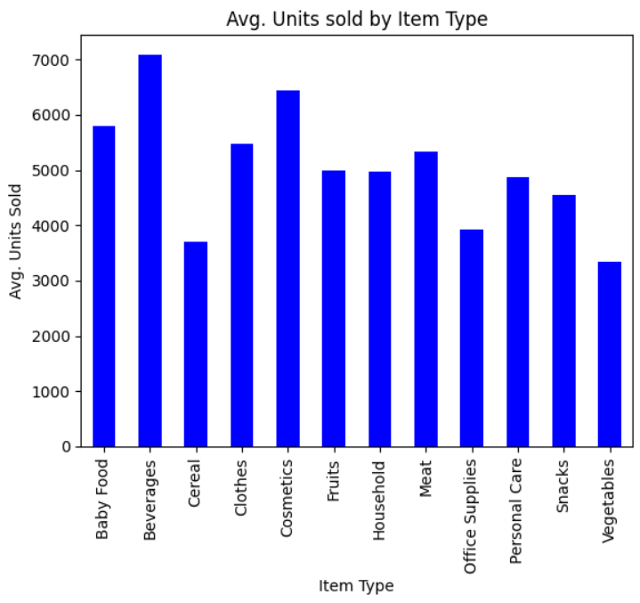
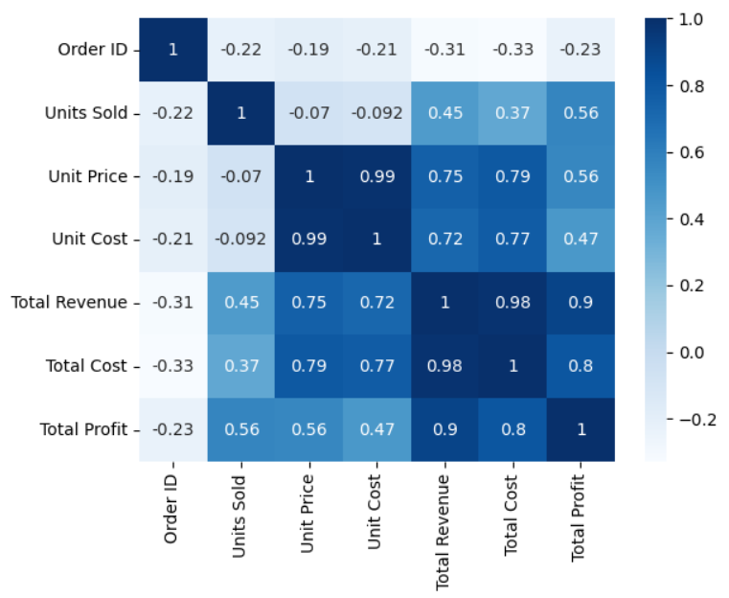
Analysis using Python

Slide 8
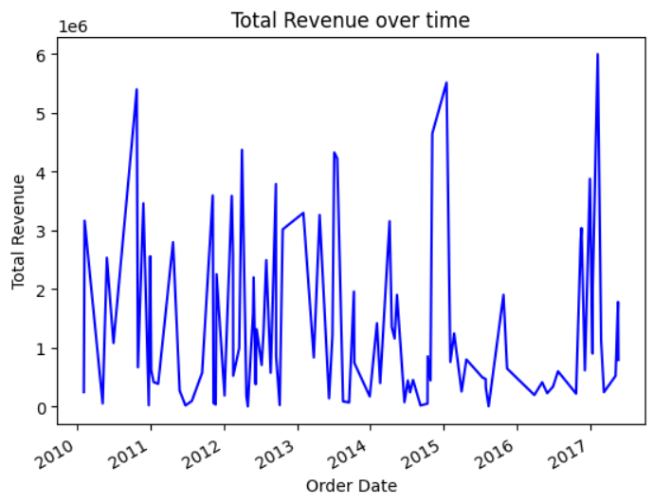
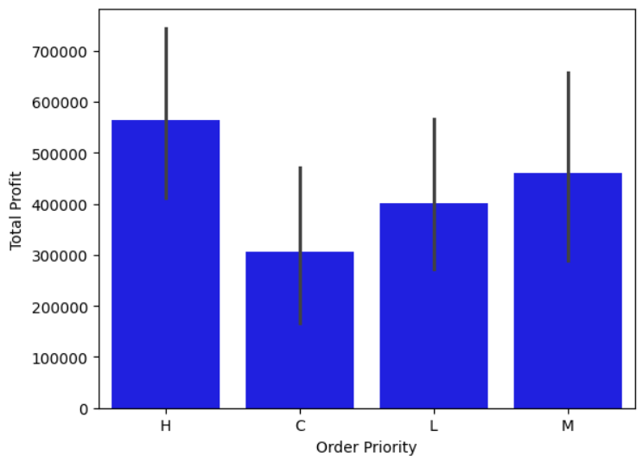
Analysis using Python

Slide 9
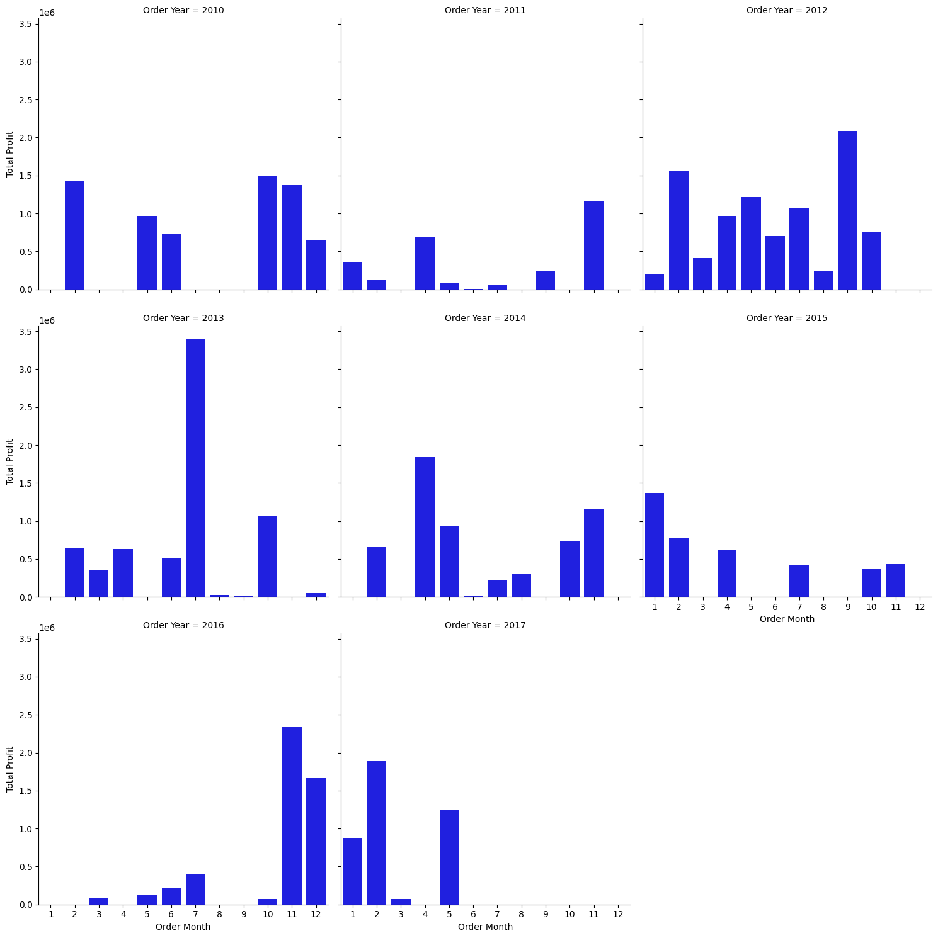
Analysis using Python

Slide 10
Tableau Dashboard

Slide 11
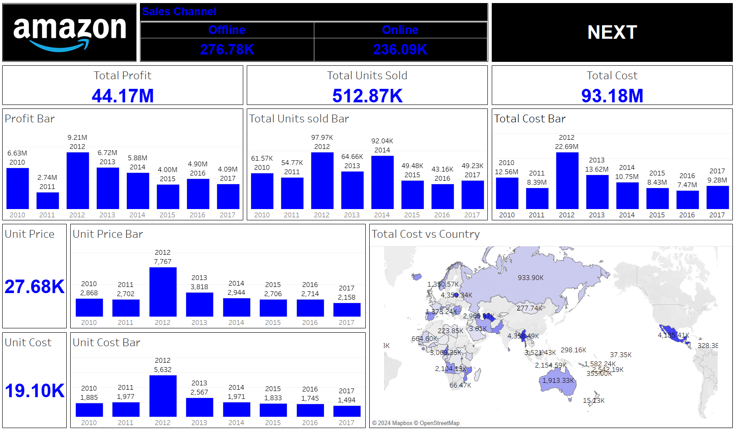
Tableau Dashboard

Slide 12
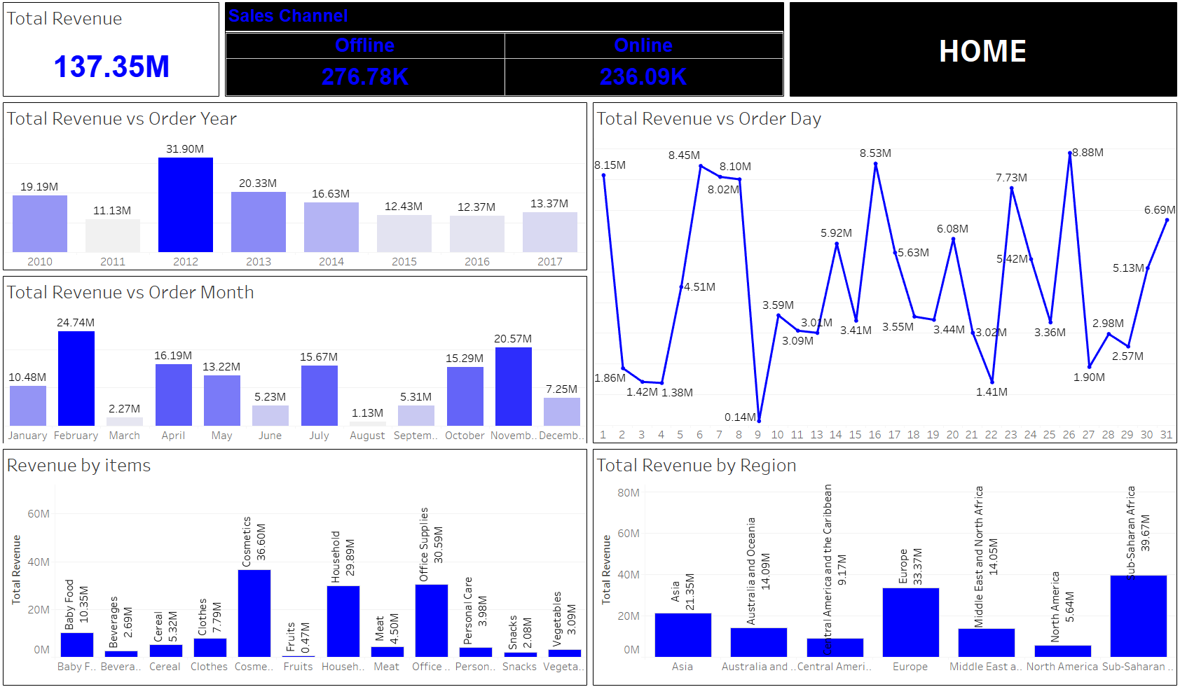

Slide 13
Insights
Financial Performance
Total Sales and Profit: With total sales of $137.35 million and a profit of $44.17 million, the business has a profit margin of approximately 32.14%, indicating a healthy profit generation from its sales activities.
Average Profit Margin: The average profit margin per unit is $32.16. This figure helps in understanding the profitability per product sold.
Average Unit Price: With an average unit price of $276.76, the business is likely dealing with mid to high-range products.
Sales Channels and Customer Preferences
Order Priority: The highest sales from “H” order priority indicate a strong customer demand for fast delivery. This suggests the importance of maintaining efficient logistics and supply chain operations to meet this need.
Sales by Product Category: "Cosmetics" leading in sales could be due to high consumer demand, possibly driven by trends, brand loyalty, or effective marketing strategies in this category.
Sales Channels: The preference for “Offline Channel” suggests that customers might value the in-store experience, personal interaction, or immediate product availability.

Slide 14
Insights
Temporal and Regional Trends
Yearly Sales Performance: The peak sales in 2012 could be analyzed further to understand the factors that contributed to this spike (e.g., economic conditions, product launches, marketing campaigns).
Regional Sales: The highest sales in the Sub-Saharan Africa region could be indicative of emerging markets, increased disposable income, or effective market penetration strategies in these areas.
Strategic Implications
Enhance Delivery Speed: Given the high sales associated with the “H” order priority, investing in logistics to ensure fast delivery could further boost sales and customer satisfaction.
Focus on Cosmetics: Strengthening the product range, marketing, and distribution of cosmetics can capitalize on this high-demand category.
Optimize Offline Sales: Improving the in-store experience, expanding offline retail presence, and integrating online-offline shopping experiences could leverage the preference for offline channels.
Analyze Peak Year Strategies: Understanding what drove the peak sales in 2012 can provide insights for replicating successful strategies in future planning.
Expand in Sub-Saharan Africa: Tailoring marketing strategies, products, and distribution networks to the preferences and needs of customers in Sub-Saharan Africa can sustain and grow sales in this region.

Slide 15


